Slide 1

Adversarial Learning for Intractable Problems
Wei Xing
Brian Ziebart, Chair and Advisor
Xinhua Zhang
Sathya Ravi
Anastasios Sidiropoulos
Thorsten Joachims, Cornell University
Notes:
Firstly, thank you for everyone who attend my thesis defense today. The topic of my thesis will be adversarial learning for intractable problems.

Slide 2
Outline
The Hard Learning Problems
Structure Learning Methods
Adversarial Learning – General
Adversarial Learning - Multiclass Classification
Adversarial Learning – 3 Dimensional Matching
Conclusion and Future Works
Notes:
It will contain 6 parts and let's begin with the hard problems we are going to face.

Slide 3
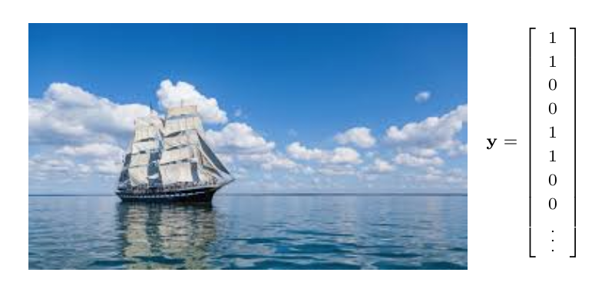
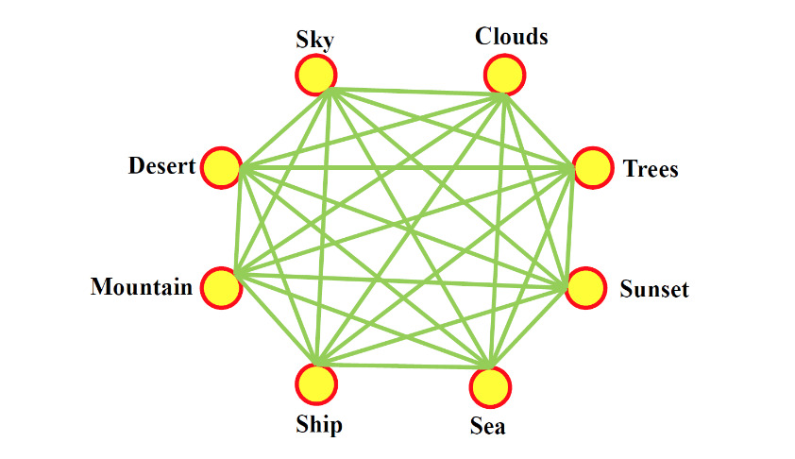
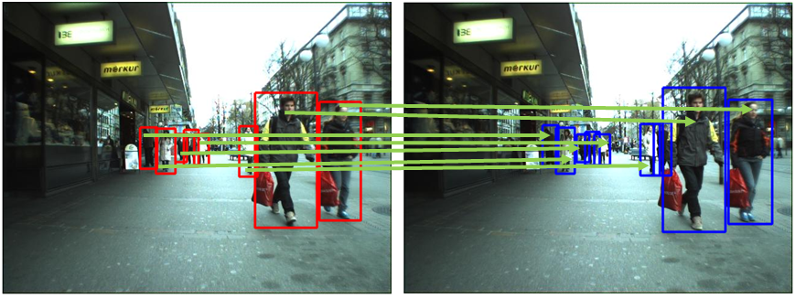
Learning Problems with Structured Output and Input
1
Multilabel Classification (Zhang et. al., 2007; Tsoumakas et.al. 2009; Behpour et.al., 2018)
2
Correspondence between images (Belongie et. al., 2002; Dellaert et. al., 2003, Fathony et. al., 2018)
Notes:
As the machine learning community had developped for so many years, it is more and more frequently that people encounter learning problem with structured data. Some of them may have structured labels such as multilabel classification.
Some other problem may have structured inputs like video tracking. And it is not rare that both inputs and outputs are structured. With the complex structures, these learning problem may encounter inner problem that could be NP-complete or even harder and we need to find ways to solve these challenges.

Slide 4
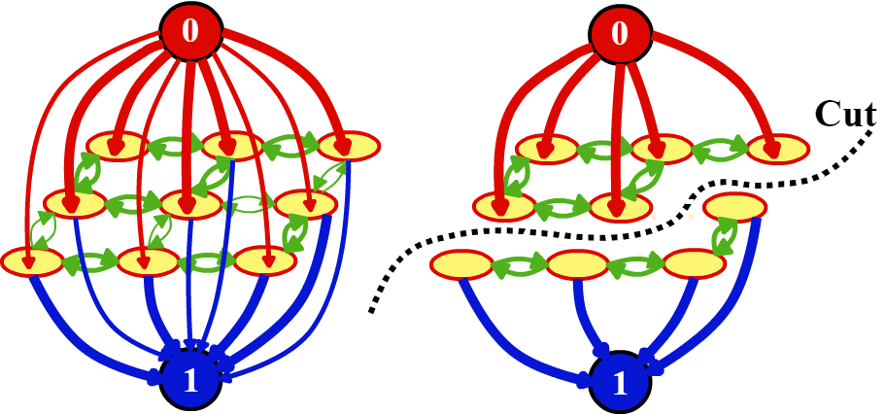
Learning Problems with Structured Output and Input
1
Multilabel Classification (Sima Behpour, Wei Xing, Brian D. Ziebart, 2018)
Max-flow min-cut
Notes:
For the binary multilabel classification problem.
It can be viewed a max-flow min-cut problem where the terminal nodes are binary labels, other nodes are attributes that needs to be classified.

Slide 5
Learning Problems with Structured Output and Input
Multiclass Structure Prediction
A
Class A: 1,2
Class B: 3
Class C: 4
1
2
B
C
3
4
Non-zero only if i and j have the same label
Multiway Cut Problem:
Must assigned with only one label
Machine learning task:
Learn the appropriate weights $ψ_{i}\left(⋅,⋅\right) and{ ψ}_{i,j}\left(⋅,⋅,⋅,⋅\right)$
Notes:
We can extend it to multiclass case by creating terminal nodes for each of the classes and construct a graph connecting each item to all the classes and connect the items themselves according to the pairwise features to form a multiway cut problem. In this problem we need to find a set of edges i.e. cuts with minimal summed weights, so that removing them will disconnect all the terminal nodes. When this is done, the items still connected with one of the terminal node can be viewed as been classified to that label.
The multiway cut problem can be viewed as this linear integral programming problem. To understand this relation, we can view the multiway cut problem in an opposite way, in which we can try to add as much nodes as possible from the graph with no edges without making the terminal nodes connected.
Those \mu s are 0-1 indicator functions telling us the connection of the edges. The constrain forcing them sum up to 1, cause all the items must be connected with only one terminal node.
The inequation constraints force two items are connected only if they are connected to the same terminal node.
And the learning problem will be given ground truth of multiway cuts, learn the appropriate weights that can lead to the given results.

Slide 6
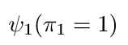
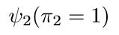
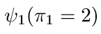
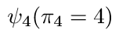
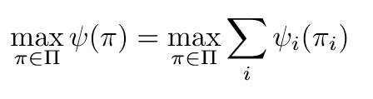
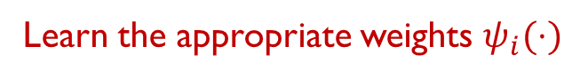
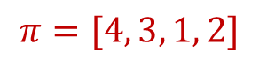
Learning Problems with Structured Output and Input
2
Correspondence between images (Fathony et. al., 2018)
1
1
2
2
$$π=[4, 3, 1, 2]$$
3
3
4
4
A
B
Maximum weighted bipartite matching:
Machine learning task:
Learn the appropriate weights $ψ_{i}(⋅)$
Notes:
Now let’s look at the problem of finding the matches between objects of two images.
It can be viewed as an bipartite matching problem where we need to find a match with the highest summed weights.
And if we are given ground truth matching results
The learning problem will be learning the appropriate weights on different matches.

Slide 7
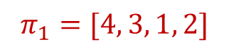
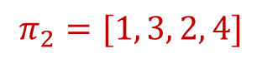
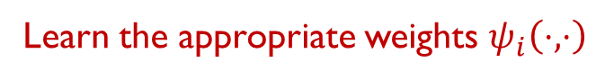
Learning Problems with Structured Output and Input
Correspondence between 3 sets of elements
3-Tuple
Potential
1
1
1
2
2
2
$$π_{1}=[4, 3, 1, 2]$$
3
3
3
$$π_{2}=[1, 3, 2, 4]$$
4
4
4
A
B
C
Maximum weighted 3D matching:
Machine learning task:
Learn the appropriate weights $ψ_{i}\left(⋅,⋅\right)$
Notes:
It is possible that we may encounter problems that requires matching with 3 sets, such as assigning different people to different places doing different tasks. Then we have 3 dimensional matching problem.
A 3 dimensional matching can be represented using a set of tuples. Remember that although we have order in the tuple, the three sets are equivalent and a tuple (1,1,3) does not mean a connect only 1 with 1 and 1 with 3 but also 1 in set A with 3 in set C.
And the whole matching can be described using two permutations \pi1 and \pi2
Each match will give us a potential \psi
Now the task is to find out the matching with highest total potential.
And in our learning task, we need to learn the appropriate potentials given sample matchings.

Slide 8
Time Complexity
Multiclass Structure Prediction
Multi-way Cut Problem: NP-Hard (Dahlhaus et. al., 1992)
Correspondence between 3 sets of elements
NP-Hard (Kann, 1991)
1
- Multiclass Classification with Pairwise Features
2
- 3D Matching on Video Objects
Notes:
Comparing with binary cases, when we extend those problems, they soon become intractable.
Nevertheless, we will try to solve them on 2 examples of these 2 problem.

Slide 9
Outline
The Hard Learning Problems
Structure Learning Methods
Adversarial Learning – General
Adversarial Learning - Multiclass Classification
Adversarial Learning – 3 Dimensional Matching
Conclusion and Future Works
Notes:
Before introducing the method used in the thesis, let’s take a look of some state of art methods for solving structure learning problem.

Slide 10


Desiderata for a Predictor
Learning objective:
seek potentials that are most compatible with the training data
Challenge:
loss functions (e.g. Hamming loss): non-continuous & non convex
Desiderata for predictor:
1
Efficiency
runtime: (low degree) polynomial time (learning & prediction)
2
Consistency
must also minimizes the loss under ideal condition (given the true distribution and fully expressive model parameters)
Notes:
All the method seek potentials that are most compatible with the training data
But we may face the challenge that the loss we used may be non-continuous or non-convex
And we still try to keep the algorithm be efficient
As well as consistent, which means given the true distribution with infinite inputs we should be able to make the loss close to zero.

Slide 11


Previous Approaches for Bipartite Matching
1
Exponential Family Random Field Approach
2
Maximum Margin Approach
Notes:
There are two main approaches for bipartite matching that has been studied - Exponential family random field approach and maximum margin approach

Slide 12





Exponential Family Random Field Approach
(Petterson et. al., 2009; Volkovs & Zemel, 2012)
Probabilistic model:
#P-hard (Valiant, 1979)
For bipartite matching:
Consistent?
produce Bayes optimal prediction in an ideal condition
Efficient?
normalization term $Z_{ψ}$ involves matrix permanent computation
impractical even for modestly-size $n=20$
Notes:
Exponential family random field approach construct a probabilistic model that describe the probability of the assignments.
It has a nice consistency property since it produces Bayes optimal prediction under an ideal condition.
However, the normalization term involves matrix permanent computation which is known to be a #P-hard problem. This makes the approach impractical even for a modestly size n equal to 20

Slide 13
Maximum Margin Approach
(Tsochantaridis et. al., 2005)
Max-margin model:
solved using constraint generation
Efficient?
polynomial algorithm for computing maximum violated constraint
(Hungarian algorithm)
Consistent?
- is based on Crammer & Singer multiclass SVM formulation
- is not consistent for distributions with no majority label (Liu, 2007)
Notes:
The maximum margin approach tries to find a maximum margin that separate the true label with the others.
The inner optimization is solved using constraint generation.
It has a nice efficiency property since the maximum violated constraint can be computed in polynomial time using Hungarian algorithm.
However, since it is based on Crammer & Singer multiclass SVM formulation, it is not consistent for distributions with no majority label.

Slide 14
Outline
The Hard Learning Problems
Structure Learning Methods
Adversarial Learning – General
Adversarial Learning - Multiclass Classification
Adversarial Learning – 3 Dimensional Matching
Conclusion and Future Works
Notes:
To build a model that can keep both efficiency and consistency, there to be the adversarial learning framework.

Slide 15
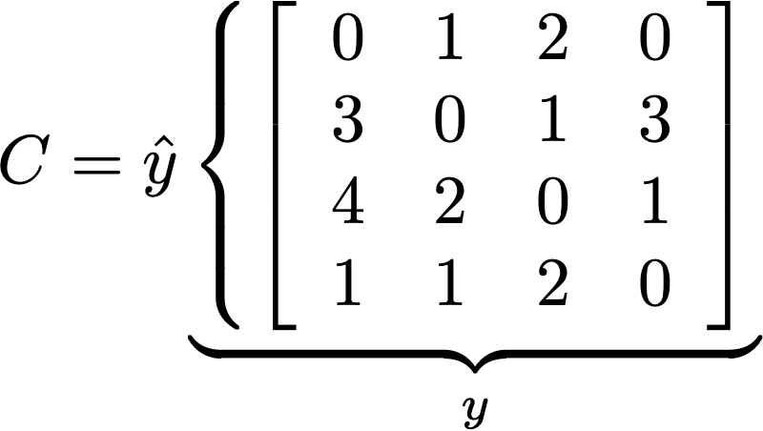
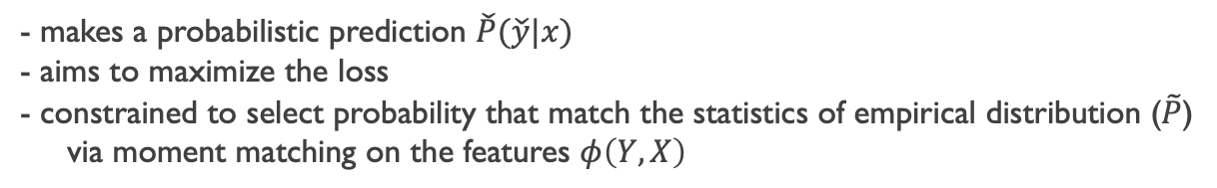
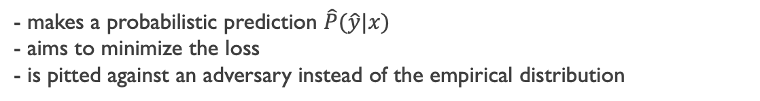
Adversarial Cost Sensitive Classification
(Kaiser Asif, Wei Xing, Sima Behpour, Brian D Ziebart, 2015)
Seek a predictor that robustly minimizes the loss
against the worst-case mixture probability
${\hat{p}}_{x}, {\check{p}}_{x}$ are the vector expression of all the probabilities in $\hat{P}(\hat{Y}|X)$ and $\check{P}(\check{Y}|X)$
Predictor:
- makes a probabilistic prediction $\hat{P}(\hat{y}|x)$
- aims to minimize the loss
- is pitted against an adversary instead of the empirical distribution
Adversary:
- makes a probabilistic prediction $\check{P}(\check{y}|x)$
- aims to maximize the loss
- constrained to select probability that match the statistics of empirical distribution ($\tilde{P}$)
via moment matching on the features $φ\left(Y,X\right)$
Notes:
To reach both goals, the approach adversarial learning was proposed. The adversarial learning tries to predict against the worst-case mixture probability - the adversary – instead of the ground truth samples.
In general, it can be written in this form.
Or alternatively the matrix form, where C is the cost matrix. Here \Ks is the place where the training data really play a role. It forces the adversary preserving certain feature statistics shown in the training samples.
Now in this game setting, one player the predictor, tries to minimize the lose
and the other player the adversary, tries to maximize the lose.

Slide 16
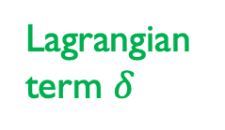
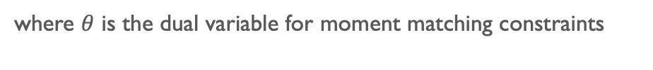
Adversarial Cost Sensitive Classification
(Kaiser Asif, Wei Xing, Sima Behpour, Brian D Ziebart, 2015)
Lagrangian term $δ$
Dual Formulation of the Cost Sensitive Classification
(methods of Lagrange multipliers, Von Neumann & Sion minimax duality)
where $θ$ is the dual variable for moment matching constraints
Augmented game matrix for $n=4$ $\text{classification}$
Inner problem is a zero-sum game which can be solved by linear programming
Notes:
Using Lagrangian multiplier method and duality
we can turn it into this form with a combined new game matrix.
The inner problem is a game which can be solved using linear programming. And the whole problem is a convex optimization for both inner game and \theta

Slide 17
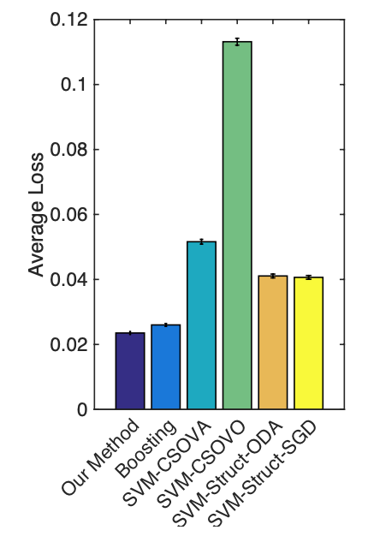
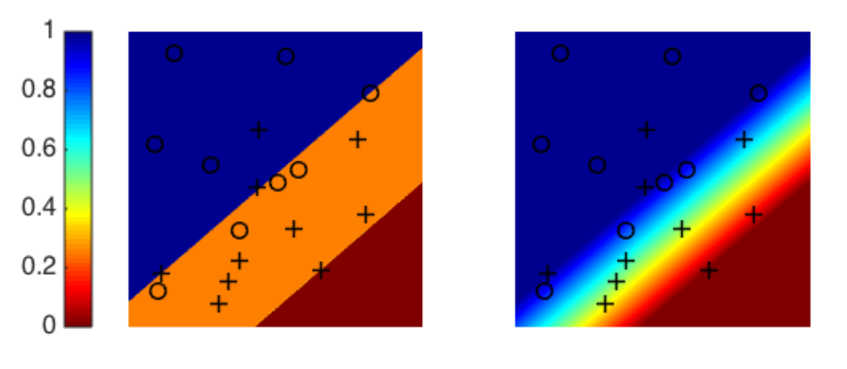
Adversarial Cost Sensitive Classification
(Asif et. al., 2015)
Adversary (left) and Predictor (right) distributions with [0 1; 3 0] cost matrix.
Average loss cross all dataset

Slide 18
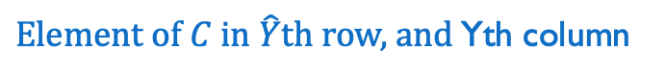
Adversarial Cost Sensitive Classification
(Kaiser Asif, Wei Xing, Sima Behpour, Brian D Ziebart, 2015)
Robust loss bound
True
Adversary
$\text{Element} \text{of} C \text{in} \hat{Y}\text{th} \text{row}\text{,} \text{and}$Yth column
Convex optimization for both inner game problem and $θ$
loss
loss
Θ
Other ERM Surrogate Loss for 0-1 Loss
Adversarial Surrogate Loss for 0-1 Loss
Notes:
Adverbial learning has a lot of advantages.
In adversarial learning, the true loss will be bounded by the adversary’s loss.
**One great advantage of the adversarial learning is that for losses that are not continuous nor convex,
Comparing with other surrogate losses,
they can be directly inserted into the objective function and automatically forms another surrogate lose that is continuous and convex.

Slide 19
Fisher Consistency
(Fisher, 1922)
Fisher Consistency
when the predictor and ground truth class labels belong to the same set of labels
Potential scoring function
Bayesian Optimal Solution
= Trained Predictor
Empirical Risk Perspective of Adversarial Learning(Fathony, 2019)

Slide 20
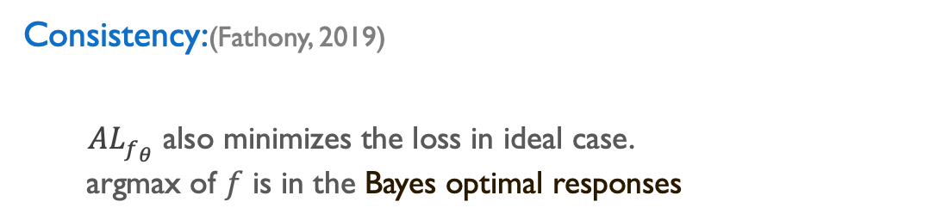
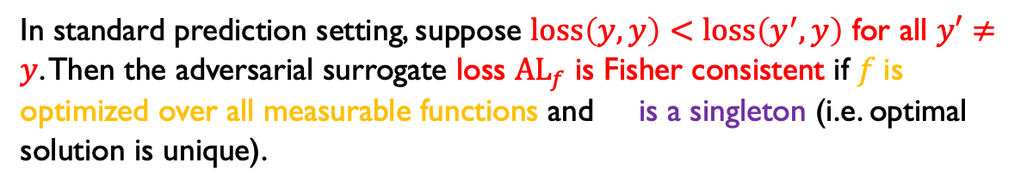
Fisher Consistency
Consistency:(Fathony, 2019)
$AL_{f_{θ}}^{}$also minimizes the loss in ideal case.
argmax of $f$ is in the Bayes optimal responses
Theorem:(Fathony, 2019)
In standard prediction setting, suppose $\text{l}\text{oss}\left(y,y\right)<\text{loss}\left(y^{′},y\right)$ for all $y′≠y$. Then the adversarial surrogate loss ${\text{AL}}_{f}$ is Fisher consistent if $f$is optimized over all measurable functions and is a singleton (i.e. optimal solution is unique).
Notes:
adversarial learning also has good consistency perperty

Slide 21
Adversarial Prediction Games for Multivariate Losses
(Hong Wang, Wei Xing, Kaiser Asif, Brian D Ziebart, 2015)
1
Precision@k
2
F-score
3
Discounted cumulative gain(DCG)
Notes:
Adversarial learning is useful on many other hard loss functions, especially the multivariate losses.

Slide 22
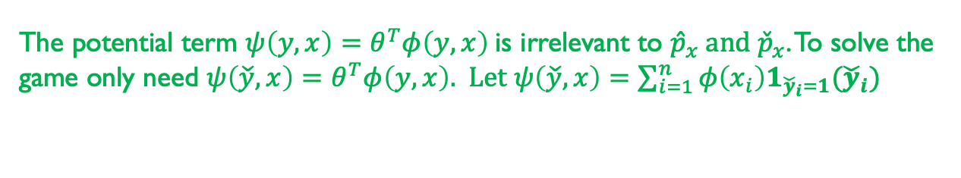
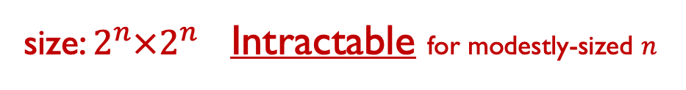
Adversarial Prediction Games for Multivariate Losses
(Hong Wang, Wei Xing, Kaiser Asif, Brian D Ziebart, 2015)
Dual Formulation of Adversarial Prediction Games for Multivariate Losses
here we try to maximize a score instead of minimizing a loss
The potential term ${ψ\left(y,x\right)=θ}^{T}φ\left(y,x\right)$is irrelevant to ${\hat{p}}_{x} \text{and} {\check{p}}_{x}$. To solve the game only need ${ψ\left(\check{y},x\right)=θ}^{T}φ\left(y,x\right)\text{.} \text{Let} ψ\left(\check{y},x\right)=\sum_{i=1}^{n}{φ\left(x_{i}\right)1_{{\check{y}}_{i}=1}({\check{y}}_{i})}$
Additive Feature
Indicator Function
Augmented matrix of F-score for $n=3 binary classification$
size: $2^{n}×2^{n}$Intractable for modestly-sized $n$
Notes:
It will have the similar object function.
But when these losses are applied, the game matrix can be exponentially large.
Like for F-score, the size can be square of two to the power of n, and we must find out a way to solve it.

Slide 23

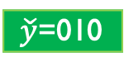
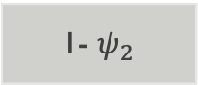
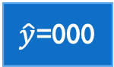
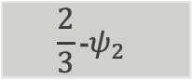
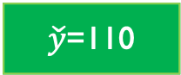
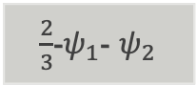
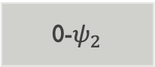
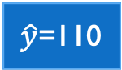
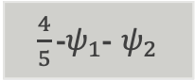

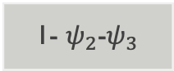
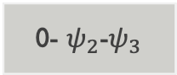

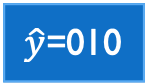
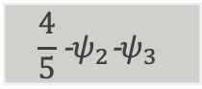

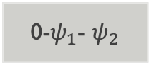
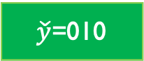
Double Oracle Method
(McMahan et. al., 2015)
Based on the observation:
equilibrium is usually supported by small number of permutations
Iterative procedure:
$\check{y}$=011
$\check{y}$=110
$\check{y}$=010
$\hat{y}$=000
0- $ψ_{2}\text{−}ψ_{3}$
0-$ψ_{1}$- $ψ_{2}$
0-$ψ_{2}$
Adversary’s best response:
$\check{y}$=110
Adversary’s best response:
1- $ψ_{2}\text{−}ψ_{3}$
$\frac{2}{3}$-$ψ_{1}$- $ψ_{2}$
1- $ψ_{2}$
$\check{y}$=010
$\hat{y}$=010
$\hat{y}$=110
$$\frac{4}{5}\text{−}ψ_{2}{\text{−}ψ}_{3}$$
$\frac{4}{5}\text{−}ψ_{1}$- $ψ_{2}$
$$\frac{2}{3}\text{−}ψ_{2}$$
Predictor’s best response:
$\hat{y}$=010
- no formal polynomial bound is known
- runtime: cannot be characterized as polynomial
Highly depend on efficient algorithm to find best response!
Predictor’s best response:
$\hat{y}$=110
Efficient: F-score, Precision@k, DCG
Inefficient: Number of inversions
Approximation methods？
Notes:
The double oracle method is based on the observation that the equilibrium is usually supported by small number of permutations.
It is an iterative procedure where it starts from a small subset of the game.
It will compute the adversary’s best response, add it to the game, and then compute the predictor’s best response and add it to the game
until there is no improvement in the game value.
This procedure doesn’t have a known polynomial bound, and therefore the runtime of the whole algorithm cannot be characterized as polynomial
And it highly depend on efficient algorithm to find best response

Slide 24
Prediction
1
Highest Probability Strategy
2
Best performance
3
Close to best performance when game matrix is exponential large
Notes:
At most, we just need to solve a inner game again to do the prediction

Slide 25

Conclusion - Learning With Precise solution
Efficient?
Consistent?
Perform well?
?
Exponential Family Random Field
(Petterson et. al., 2009;
Volkovs & Zemel, 2012)
---
Maximum Margin
(Tsochantaridis et. al., 2005)
Adversarial Learning
(our approach)
Notes:
In conclusion.
Exponential Family random field, it is consistent but not efficient. We didn’t test the performance since it is impractical for most cases.
Maximum Margin, it is efficient but not consistent. We also show that the performance is not as good as our method in video tracking application.
Finally, our adversarial bipartite matching. It is efficient and consistent, and also perform well in the experiment.

Slide 26
Outline
The Hard Learning Problems
Structure Learning Methods
Adversarial Learning – General
Adversarial Learning - Multiclass Classification
Adversarial Learning – 3 Dimensional Matching
Conclusion and Future Works

Slide 27
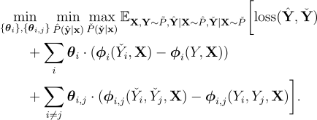
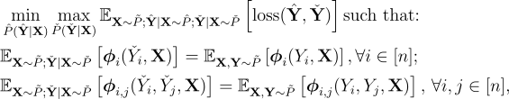
Adversarial Multiway Cut
Object Function of the Adversarial Multiway Cut
Dual Formulation of the Adversarial Multiway Cut
Hamming Loss:
Pairwise feature and Lagrangian
Notes:
No need to keep same sign

Slide 28
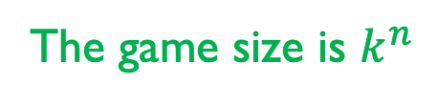
Adversarial Multiway Cut
Game marix for Adversarial Multi-way Cut
The game size is $k^{n}$
Need double oracle！

Slide 29


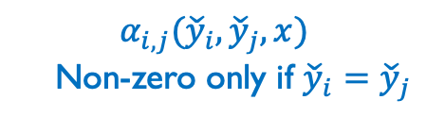

Adversarial Multiway Cut
Adversary’s Best Response
Left over inner problem
$$α_{i}({\check{y}}_{i},x)$$
$$α_{i,j}({\check{y}}_{i},{\check{y}}_{j},x)$$
Non-zero only if ${\check{y}}_{i}={\check{y}}_{j}$
Add indicator variables $μ_{i,k}$
Add indicator variables $μ_{i,j}^{(k)}$

Slide 30
Adversarial Multiway Cut
Adversary’s Best Response
A
1
2
B
C
3
4

Slide 31
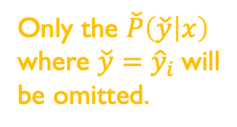
Adversarial Multiway Cut
Predictor’s Best Response
Only the $\check{P}\left(\check{y} | x\right)$ where $\check{y}={\hat{y}}_{i}$will be omitted.
Simply pick the label with highest conditional probability

Slide 32
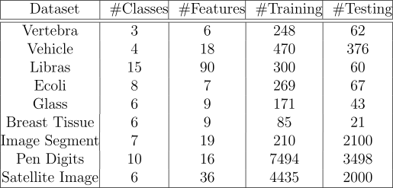
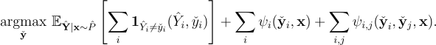
Experiment Results
Add pairwise features to normal multiclass classification
Adversary’s Best Response
Notes:
In the common sense, if two nodes have close features, they turn to belong to the same class. This pairwise features allow adversarial assigning the same label to the two far away nodes, fulfilling our desire to make the adversarial increase the loss as possible as it can.

Slide 33
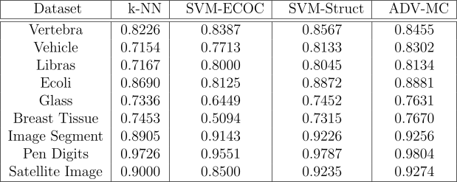
Experiment Results
Average accuracy
No pairwise feature
With pairwise feature
ALL pairs of dataset
Adding pairwise feature increase accuracy
8 pairs of results
outperform SSVM
1 pair of result
worse than SSVM

Slide 34
Outline
The Hard Learning Problems
Structure Learning Methods
Adversarial Learning – General
Adversarial Learning - Multiclass Classification
Adversarial Learning – 3 Dimensional Matching
Conclusion and Future Works
Notes:
Now let’s look at how adversarial learning is used to solve the 3D matching problem.

Slide 35
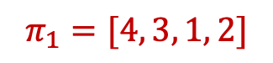

Model Presetting
1
1
1
2
2
2
$$π_{1}=[4, 3, 1, 2]$$
3
3
3
$$π_{2}=[1, 3, 2, 4]$$
4
4
4
A
B
C
Additive features:
Augmented Hamminl loss：
Notes:
Remember that the 3D matching problem’s goal is to maximize an additive potential over a set of 3-tuples.
So we model the 3D matching as if they also have additive features.
And to evaluate the matching results, we use the augmented Hamming loss which basically give 0 loss when a 3-tuple exactly matches the ground truth, otherwise give 1 loss.

Slide 36


Adversarial 3 Dimensional Matching
Object Function of the 3 Dimensional Matching
Dual Formulation of the 3 Dimensional Matching
Augmented Hamming loss matrix for $n=3$3D Matching
size:
$${(n!)}^{4}$$
Intractable
for modestly-sized $n$
Notes:
It is not hard to plug the features and losses into the general adversarial learning formula,
but it is no wonder that the 3D matching problem leads to a very large game matrix
whose size is n factorial to the power of 4.
What is the status space after using marginal method?

Slide 37



Marginal Distribution Formulation
Permutation Tensor Y :
Hyperplane Stochastic Tensor(HST):
Y, P, Q and other non-negative tensor that satisfy these 3 conditions
Marginal Distribution Tensor P and Q: linear combination of Y
${\text{Feature} \text{Tenser} \text{X}}_{o}:$
$(i,j,k)$th cell represents the $o$th entry of $φ_{i}(j,k,x)$
Notes:
Enlighted by the adversarial bipartite matching paper, we find out that we can also solve the training optimization problem in the marginal tensor space. For a 3D matching, we can express it as a 0-1 permutation tensor in which each hyperplane in any of the 3 dimensions, have only 1 non-zero element.
The mixture of the matching strategies also satisfies the conditions except the 0-1 requirement.
We call this kind of tensors hyperplanar stochastic tensors or HST.
We can also form tensor Xo for the features.

Slide 38


Adversarial Multiway Cut
Adversary’s Best Response
Rewrite using tensor form
Additive Feature
Integral Linear Programming
NP-Complete(Papadimitriou, 1981)

Slide 39


Adversarial Multiway Cut
Predictor’s Best Response
Rewrite using tensor form

Slide 40
Marginal Formulation
The marginal formula:
Dual form of the marginal formula:
In training, no hard 3D matching problem
In testing, have to use marginal to do prediction
could be hard
Notes:
Using the tensor form and duality, the original problem can be rewritten.
Now the inner game becomes a problem where only O(n^3)[big-O n cube] number of variables need to be learnt.
This method magically removed the hardness in the training phase, and this is the biggest value of the marginal trick.
But it is not totally free. After the transformation, we can only learn a marginal tensor in the prediction stage and getting the exact best matching from it can be hard.

Slide 41


Optimization
add regularization and smoothing penalty
Outer Q: projected Quasi-Newton
Inner problem $θ:$analytical expression:
number of samples
Inner problem P$:$projection to hyperplane stochastic tensor
Notes:
Although we reduce the number of variables, it is not trivial to solve the marginal problem. For the outer Q we can use a lot methods such as projected Quasi-Newton.
For the inner \theta, we have an analytical expression.
And for the inner p, it is equivalent to projecting a tensor to the the HST space.

Slide 42


ADMM for Tensor Projection
(Douglas et. al., 1956; Glowinski et. al., 1956; Boyd et. al., 1956)
ADMM: divide the problem to 3 set of variable who satisfy each of the HST condition separately
auxiliary variables
indicator function that is 1 only if $C_{i} is satisfied$
$C_{i}$ stands for each of the HST condition
A$ugmented Lagrangian: alternately updating variables$
Notes:
To solve the projection problem we use the ADMM method.
It divides the problem into 3 parts
by adding additional auxiliary variables
and each part only needs to satisfy one direction of the HST conditions

Slide 43
ADMM for Tensor Projection
(Douglas et. al., 1956; Glowinski et. al., 1956; Boyd et. al., 1956)
ADMM: Original problem can be solved using a iterative updating strategy
Projection onto the tensor space that satisfy one of the three directions of the HST condition.
Notes:
ADMM allows us to solve it by an iterative updating strategy.
After separation, now these projections can be done independently for each hyperplane of the tensor.

Slide 44
Prediction
What we got is a marginal distribution which should be recovered back to mix of strategies.
Set{Hyperlanar Stochastic Tensors} ？ Set{Mixture of Permutation Tensors}
Learned Marginal Tensor
Predicted Matching
Use Integer Quadratic Programming to solve it.
Notes:
For prediction, we only get a marginal tensor after solving the game.
A problem is whether the space of the HST the same as the space of mixture of permutation tensors? If not, the learned marginal tensor may not be a mixture strategy.
Nevertheless, instead of restoring a distribution of strategies, here we directly learn a matching Y that is closest to the predicted marginal tensor.
This is an integer quadratic programming problem and NP-hardness appears here. We use approximation methods to solve it.

Slide 45
Comparison Methods
2 Stage Adversarial Marginal Bipartite Matching(2S-AdvMarg)
(Fathony et. al., 2018)
On leverage the pairwise information of two sets
Simply concatenate the results
Structured SVM(SSVM)
(Joachims, 2008)
Also only used for solving the marginal problem.
Same prediction method as Adv3DMarg after retrieving the marginal tensor
Adversarial 3D Matching(Adv3DMarg)
Notes:
To test our adversarial 3D matching algorithm we compare it with two other ones.
2 stage adversarial bipartite matching.
and structured SVM.

Slide 46


Experiment Setup – Synthetic Data
Synthetic data generating
1. Decide problem size $n.$
2. Generate $3n$ object for three stages and generate atom feature $X_{i,k}$for each of the object.
3. Calculate feature $φ_{i}(π_{1,i},π_{2,i},X_{i,1},X_{π_{1,i},2 },X_{π_{2,i},3 })$ for later use.
4. Generate weight vector $w.$
Stage
Position
5. Get ground truth by exhaustedly searching ${argmax}_{π_{1},π_{2}}w∙φ\left(π_{1}, π_{2},X\right).$
Feature Used
Notes:
We first tried them on some synthetic data
using some general numerical features.

Slide 47

Experiment Results – Synthetic Data
Data set information
n=3, 4, 5, 6 Number of w per n: 10, Number of samples per w: 50
Direct evaluation on marginal distribution is done
3 pairs of dataset
Double oracle got best results
Notes:
The results showed that the 3D matching worked better in general.

Slide 48
Experiment Setup – Video Tracking
TUD and ETH Video Tracking Dataset
(Leal-Taixé, et. al., 2015)
Ground truth bounding boxes are used as objects.
Data are divided into samples each of them contains 3 frames.
Virtual objects are added to make the number of objects in all the 3 frames be the same.
Notes:
We also applied the algorithms on video tracking dataset TUD and ETH.
We used several methods to transform it into a 3D matching problem.

Slide 49

Experiment Results – Video Tracking
Feature Used
Intersection Over Union
Euclidean distance
21 color histogram distance
21 local binary pattern
Optical flow
Stage Indicator variables
Marginal method best on all dataset
Significantly better on 4/8 dataset
Notes:
Here are the results.
We adopted several commonly used image features.
The results also showed that considering 3 frames together helped and adversarial learning performed better than structure SVM here.

Slide 50
Outline
The Hard Learning Problems
Structure Learning Methods
Adversarial Learning – General
Adversarial Learning - Multi-class Classification
Adversarial Learning – 3 Dimensional Matching
Conclusion and Future Works
Notes:
Now let's make a conclusion and think about possible directions for future works.

Slide 51
Conclusion
1
We tried to solve the intractable problems using adversarial learning with double oracle. They all get reasonable results. On multiclass classification it perform well, but on 3D matching it is not that good.
2
We developed marginal method on 3D matching and find out the great potential of this idea: Avoid solving hard problems in training phase and leaving it to prediction to save the time.
3
The experiments showed that if we add features such as adding pairwise features to normal classification problems or consider 3 sets all together instead of 2 stage bipartite matching, we can make use the potential information hiding in the correlation of data with the cost of more computation time.
Notes:
In this paper we extended the marginal method to 3D matching and succeeded in avoiding solving NP-hard problems in training.
*It is efficient in two different ways. The first one is that we avoided solving NP-hard inner problems in the training stage. The second one is that we avoid directly solving the exponentially large game matrix.
We solved the math problems in optimizing the marginal tensor objective function.
And the experiments showed the 3D matching performs better than two stage bipartite matching and adversarial learning worked well in learning marginal tensors.

Slide 52
Conclusions - Learning With Approximation Method
Efficient?
Good bound?
Perform well?
?
?
Exponential Family Random Field
(Petterson et. al., 2009;
Volkovs & Zemel, 2012)
---
Maximum Margin
(Tsochantaridis et. al., 2005)
(Finley et. al., 2005)
?
Adversarial Learing
(our approach)
Notes:
No longer get totally consistent
Exponential Family random field, it is consistent but not efficient. We didn’t test the performance since it is impractical for most cases.
Relaxation (loosing the condition of variables) is generally good for SVM. We also use it for Multi-way cut.

Slide 53
Future Works
1
Explore N-D Matching and prove the relation between mixture of permutation tensors and stochastic tensors.
2
Proof theoretical bound for adversarial learning methods when using approximation algorithms.
3
Apply the methods to other intractable problems, such as directly using it on video tracking.
Notes:
For the future works.
Firstly, a mixture of permutation tensors is a HST, but it is still a open question whether the opposite direction is true.
Secondly, we may figure out the general form of the marginal method for higher dimensional matchings and see whether it is worthy to use it.
Thirdly, we can find other areas where pushing the hardness in training to the prediction stage is possible and useful.

Slide 54
Related Publications
Kaiser Asif, Wei Xing, Sima Behpour, Brian D Ziebart. “Kaiser Asif, Wei Xing, Sima Behpour, Brian D Ziebart” In Proceedings of the Conference on Uncertainty in Artificial Intelligence (UAI, 2015)
Hong Wang, Wei Xing, Kaiser Asif, Brian D Ziebart. “Adversarial Prediction Games for Multivariate Losses” In Proceedings of the Advances in Neural Information Processing Systems (NIPS, 2015)
Sima Behpour, Wei Xing, Brian D. Ziebart. “ARC: Adversarial Robust Cuts for Semi-Supervised and Multi-Label Classification” In Proceedings of the IEEE Conference on Computer Vision and Pattern Recognition Workshops (IEEE/CVF, 2018)
Rizal Fathony, Kaiser Asif, Anqi Liu, Mohammad Ali Bashiri, Wei Xing, Sima Behpour, Xinhua Zhang, Brian D Ziebart. “Consistent robust adversarial prediction for general multiclass classification” arXiv preprint arXiv:1812.07526 (2018)
Wei Xing, Brian D Ziebart. “Adversarial Learning for 3D Matching” In Proceedings of the Conference on Uncertainty in Artificial Intelligence (UAI, 2020)

Slide 55
References
Zhang, M.-L., and Zhou, Z.-H. 2007. Ml-knn: A lazy learning approach to multi-label learning. Pattern recognition 40(7):2038–2048.
Tsoumakas, G.; Katakis, I.; and Vlahavas, I. 2009. Mining multi-label data. In Data mining and knowledge discovery handbook. Springer. 667–685.
Behpour, S., Xing, W., and Ziebart, B. D. 2018. ARC: Adversarial robust cuts for semi-supervised and multi-label classification. In Proceedings of the AAAI Conference on Artificial Intelligence, pages 2704–2711
Belongie, S., Malik, J., and Puzicha, J. 2002. Shape matching and object recognition using shape contexts. IEEE transac- tions on pattern analysis and machine intelligence, 24 (4):509–522.
Dellaert, F., Seitz, S. M., Thorpe, C. E., and Thrun, S. 2003. EM, MCMC, and chain flipping for structure from motion with unknown correspondence. Machine learning, 50 (1-2):45–71.
Fathony, R., Behpour, S., Zhang, X., and Ziebart, B. 2018. Efficient and consistent adversarial bipartite
matching. In International Conference on Machine Learning, pages 1456–1465.

Slide 56
References
E. Dahlhaus, D.S. Johnson, C.H. Papadimitriou, P.D. Seymour, and M. Yannakakis. 1992. The complexity of multiway cuts. In Proceedings, 24th Annual ACM Symposium on Theory of Computing.
Kann, V., 1991. Maximum bounded 3-dimensional matching is MAX SNP-complete. Information Processing Letters, 37(1), pp.27-35.
Petterson, J., Yu, J., McAuley, J. J., and Caetano, T. S. 2009. Exponential family graph matching and ranking. In Ad- vances in Neural Information Processing Systems, pp. 1455–1463.
Volkovs, M. and Zemel, R. S. 2012. Efficient sampling for bi- partite matching problems. In Advances in Neural Infor- mation Processing Systems, pp. 1313–1321.
Valiant, L. G. 1979. The complexity of computing the permanent. Theoretical computer science, 8(2):189–201.
Tsochantaridis, I., Joachims, T., Hofmann, T., and Altun, Y. 2005. Large margin methods for structured and interdependent output variables. Journal of machine learning research, 6(Sep):1453–1484.

Slide 57
References
Asif, K.; Xing, W.; Behpour, S.; and Ziebart, B. D. 2015. Adversarial cost-sensitive classification. In Proceedings of the Conference on Uncertainty in Artificial Intelligence.
von Neumann, J. and Morgenstern, O. 1947. Theory of Games and Economic Behavior. Princeton University Press.
Wang, H.; Xing, W.; Asif, K.; and Ziebart, B. 2015. Adversarial prediction games for multivariate losses. In
Advances in Neural Information Processing Systems, 2728–2736.
H Brendan McMahan, Geoffrey J Gordon, and Avrim Blum. 2003. Planning in the presence of cost functions controlled by an adversary. In Proceedings of the International Conference on Machine Learning, pages 536–543.
Fisher, R.A., 1922. On the mathematical foundations of theoretical statistics. Philosophical Transactions of the Royal Society of London. Series A, Containing Papers of a Mathematical or Physical Character, 222(594-604), pp.309-368.
Fathony, R.Z.A., 2019. Performance-Aligned Learning Algorithms with Statistical Guarantees (Doctoral dissertation, University of Illinois at Chicago).

Slide 58
References
Douglas, J. and Rachford, H.H., 1956. On the numerical solution of heat conduction problems in two and three space variables. Transactions of the American mathematical Society, 82(2), pp.421-439.
Glowinski, R. and Marroco, A., 1975. Sur l'approximation, par éléments finis d'ordre un, et la résolution, par pénalisation-dualité d'une classe de problèmes de Dirichlet non linéaires. ESAIM: Mathematical Modelling and Numerical Analysis-Modélisation Mathématique et Analyse Numérique, 9(R2), pp.41-76.
Boyd, S., Parikh, N., Chu, E., Peleato, B. and Eckstein, J., 2011. Distributed optimization and statistical learning via the alternating direction method of multipliers. Foundations and Trends® in Machine learning, 3(1), pp.1-122.
Finley, T. and Joachims, T., 2008, July. Training structural SVMs when exact inference is intractable. In Proceedings of the 25th international conference on Machine learning (pp. 304-311). ACM.
Papadimitriou, C. H.: On the complexity of integer programming. Journal of the ACM (JACM),
28(4):765–768, 1981

Slide 59
Thank You
Notes:
Thank you

